Slide 1
Ethics in Information Technology, Fourth Edition
Chapter 5
Freedom of Expression

Slide 2
It is easy to believe in freedom of speech for those with whom we agree.
—Leo McKern, Australian actor

Slide 3
Objectives
As you read this chapter, consider the following questions:
What is the basis for the protection of freedom of expression in the United States, and what types of expression are not protected under the law?
What are some key federal laws that affect online freedom of expression, and how do they impact organizations?
What important freedom of expression issues relate to the use of information technology?

Slide 4
Freedom of Expression and Internet
Internet Enables
News – ideas-rumors-information
Open discussions – anonymity
Ethical use of this freedom and power
Government and organizations have made laws and policies to guide people in this and protect their own interest
Right of freedom of expression
First amendment guarantee this right
Several federal/state laws found unconstitutional

Slide 5
First Amendment Rights
Definition of free speech includes:
Nonverbal, visual, and symbolic forms of expression
Right to speak anonymously
A speech highly unpopular for majority – protection of minority views

Slide 6
First Amendment Rights (cont’d.)
Not protected by the First Amendment
Perjury
Fraud
Defamation
Obscene speech
Incitement of panic
Incitement to crime
“Fighting words”
Sedition
Obscene speech and Defamation relevant to IT

Slide 7
Obscene Speech
Based on Miller v. California, speech is considered obscene when:
Lacks serious literary, artistic, political, or scientific value

Slide 8
Defamation
Oral or written statement of alleged fact that is:
False
Harms another person
Harm is often of a financial nature
Slander
Oral defamatory statement
Libel
Written defamatory statement
Care in online communication to avoid charges of defamation
Organizations prepared to take actions against libelous attacks

Slide 9
Freedom of Expression: Key Issues
Controlling access to information on the Internet
Anonymity on the Internet
Defamation and hate speech
Corporate blogging
Pornography

Slide 10
Controlling Access to Information on the Internet
Freedom of speech on the Internet is complicated by ease by which children can access Internet
Laws and software to block questionable material
Communications Decency Act (CDA 1996)
Aimed at protecting children from pornography
Broad language and vague definition of indecency
Found unconstitutional in 1997

Slide 11
Controlling Access to Information on the Internet (cont’d.)
Child Online Protection Act (COPA 1998)
Applies to communication for commercial purposes
Imposes penalties for exposing minors to harmful material on the Web
Found unconstitutional in 2004
Internet filtering
Software installed with a Web browser
Blocks access to certain Web sites deemed to contain inappropriate or offensive material

Slide 12
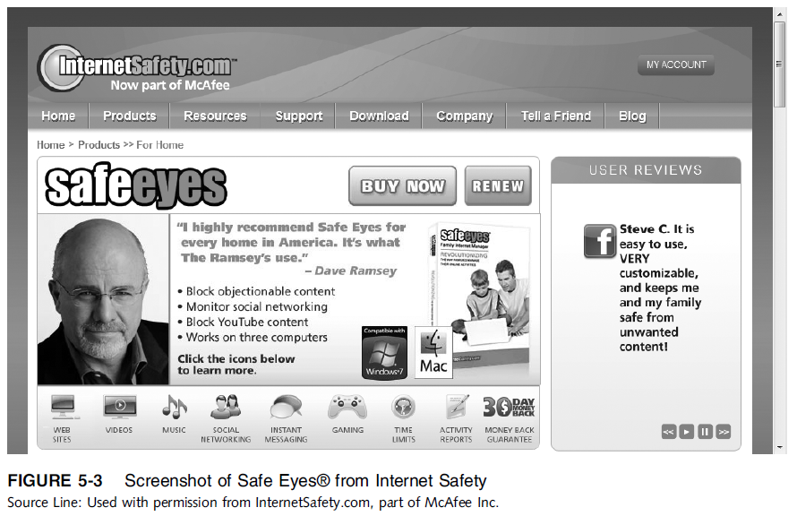
Ethics in Information Technology, Third Edition
12
Notes:
12

Slide 13
Controlling Access to Information on the Internet (cont’d.)
URL filtering
Blocks objectionable URLs or domain names
Keyword filtering
Blocks keywords or phrases
Dynamic content filtering
Web site’s content is evaluated immediately before being displayed
Uses
Object analysis
Image recognition

Slide 14
Controlling Access to Information on the Internet (cont’d.)
Top-rated Internet filters for home users
NetNanny Parental Controls
PureSight PC
CYBERsitter
SafeEyes
CyberPatrol

Slide 15
Controlling Access to Information on the Internet (cont’d.)
ICRA rating system
Questionnaire for Web authors
Generates a content label
Platform for Internet Content Selection (PICS)
Users configure browsers to read the label
Relies on Web authors to rate their site
Complement to other filtering techniques

Slide 16
Controlling Access to Information on the Internet (cont’d.)
ISP blocking
Blocking is performed on the ISP server
ClearSail/Family.NET prevents access to certain Web sites
List is updated

